Slide 1


Project Proposal: High-Fidelity Image Inpainting using Diffusion Models
A forward-looking research initiative to leverage the power of modern generative models for contextually accurate and perceptually superior image reconstruction.
Nur Ibne Kawsar Zitu ( 2212021042 )
Kazi Tazrian Mon ( 2132798642 )
Md. Minhajul Islam ( 2211022042 )

Slide 2




Introduction & Motivation
The Quest for Seamless Image Inpainting
Image inpainting—the reconstruction of missing or corrupted regions—is crucial for applications like image restoration, object removal, and digital content creation. Traditional methods often yield blurry or artifact-ridden results when dealing with large, complex masks.
The Challenge
Generating semantically consistent and visually realistic content for large missing areas within a high-resolution context.
The Limitation
Traditional convolutional methods struggle with contextual accuracy and fidelity, resulting in noticeable boundary artifacts and blurriness.
The Solution
Leveraging Diffusion Models' superior ability to generate high-quality, diverse, and texture-rich content.

Slide 3
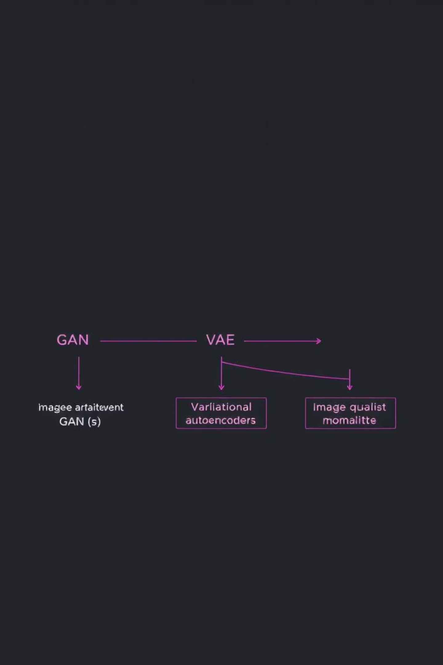

Technical Background
Evolution of Generative Models for Inpainting
While previous models laid the groundwork, Diffusion Models offer a new paradigm for quality, diversity, and training stability in high-fidelity image synthesis.
GANs (Generative Adversarial Networks)
VAEs (Variational Autoencoders)
Offer stable training and good latent space interpolation but typically produce outputs that are perceptually softer, lacking the sharpness of high-end generative models.
Synthesize highly realistic, local textures but often suffer from training instability, mode collapse, and lack of diverse, global coherence.
Diffusion Models (DMs)
Progressively denoise random noise back into a target image. Excel in generating ultra-high-quality images, modeling complex data distributions, and providing high sample diversity.

Slide 4






Project Objectives: Defining Success
Our primary goal is to develop an optimized Diffusion Model-based framework that sets a new benchmark for inpainting fidelity across multiple evaluation criteria.
Develop Robust Architecture
Handle Irregular Masks
Optimize Inference Speed
Implement a novel DM-based inpainting architecture capable of learning complex, conditional data distributions effectively.
Ensure effective performance across diverse, complex mask shapes and sizes, crucial for real-world object removal tasks.
Investigate and integrate accelerated sampling methods (e.g., DDIM, DPM-Solver) to significantly reduce computational time for practical deployment.
Evaluate Perceptual Quality
Benchmark Against SOTA
Utilize both objective feature-level metrics (LPIPS, FID) and subjective human evaluations to guarantee realism.
Rigorously compare the proposed approach against leading generative inpainting methods to establish state-of-the-art performance.

Slide 5










Methodology Overview
The Four Pillars of Our Approach
Our comprehensive methodology spans data preparation, customized architecture design, rigorous training, and comprehensive evaluation.
Data Preparation & Masking
Model Architecture Design
Utilize high-resolution datasets (Places365, ImageNet) with diverse mask strategies: free-form irregular, random rectangles, and saliency-driven perceptual masks.
Adapt DDPM/LDM architectures. Key features include explicit conditioning on the unmasked image/mask, and leveraging a U-Net backbone.
Evaluation Strategy
Training & Optimization
Combine quantitative metrics (PSNR, SSIM, LPIPS, FID) with extensive qualitative visual inspection and small-scale user studies for human perception assessment.
Train on powerful GPUs (A100/V100). Focus on hyperparameter tuning and integration of accelerated sampling techniques (DDIM, DPM-Solver) for efficiency.
This structured approach ensures both technical novelty and practical effectiveness in real-world scenarios.

Slide 6
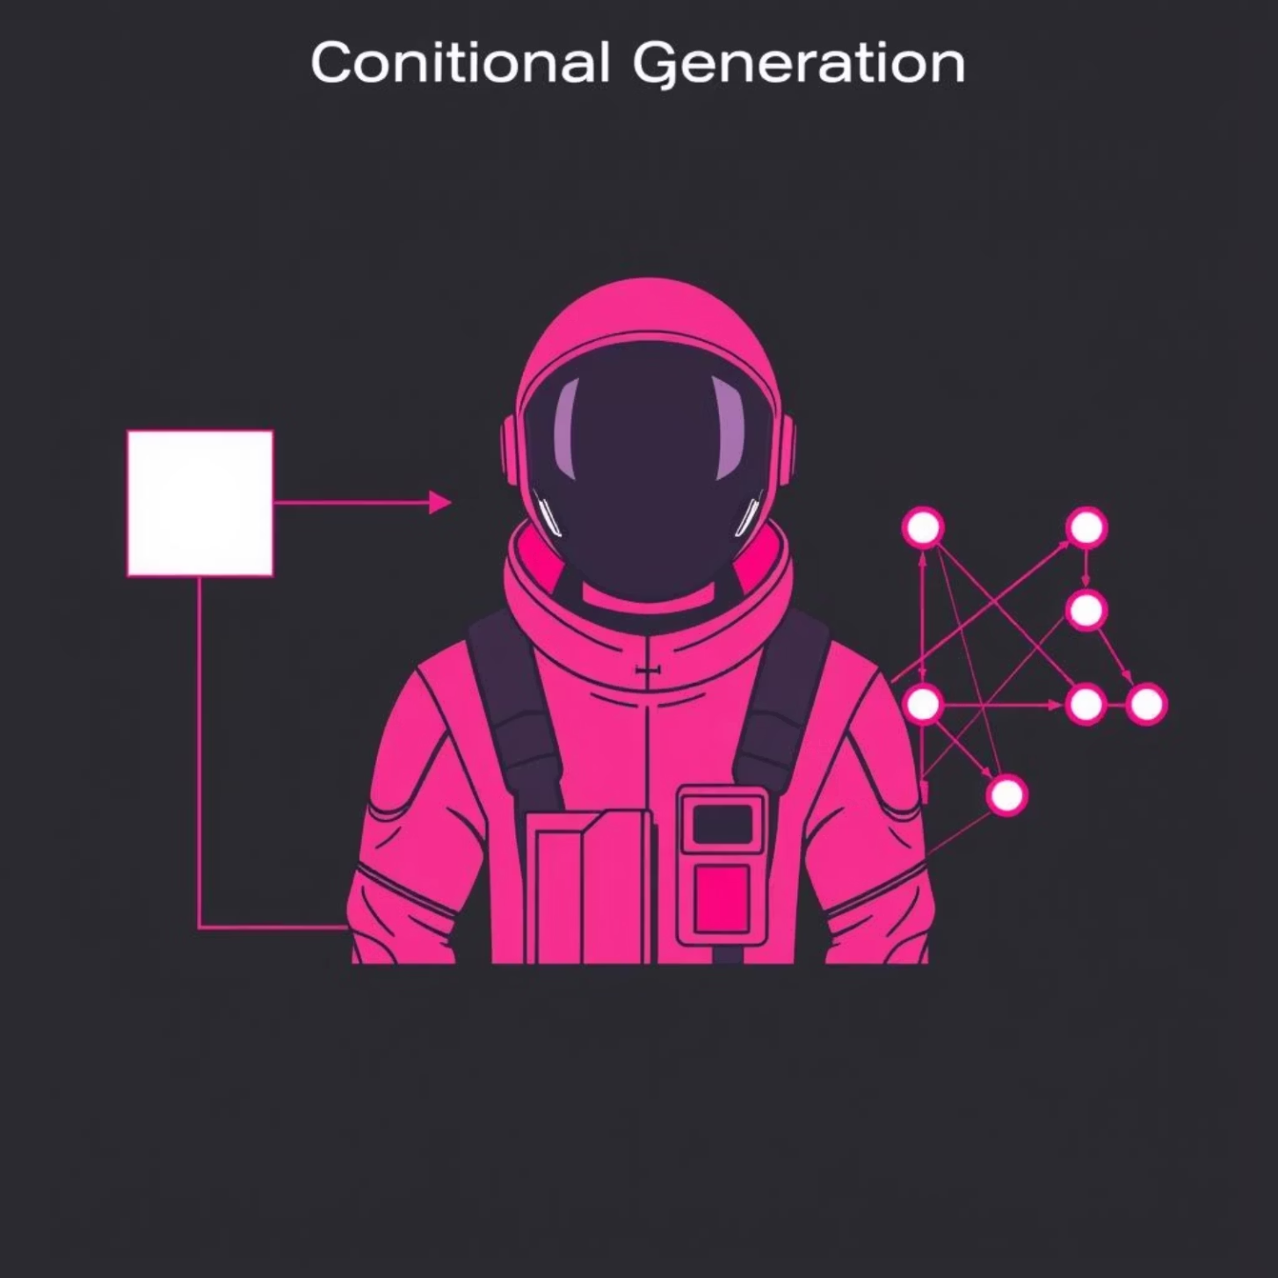


Architectural Deep Dive: Conditional Inpainting
Conditional Generation
The U-Net denoiser receives both the masked image and the mask itself. These are typically concatenated as additional input channels, enabling the model to explicitly understand which areas need reconstruction and what context is available.
Masked Sampling in the Reverse Process
During the iterative denoising process, the known pixels in the unmasked regions are iteratively preserved, ensuring the integrity and structural coherence of the original content. Only the masked regions are actively sampled and generated at each timestep.
Preserve known pixels from the input image.
Generate unknown pixels iteratively using the diffusion process.

Slide 7






Optimization & Metrics
Bridging the Gap Between Pixel-Level Fidelity and Perception
Our success is measured not just by simple pixel matching, but by human-level perceptual quality and operational speed, making the model practically useful.
Inference Optimization
Evaluation Metrics
Diffusion model inference is inherently slow due to the high number of required sequential sampling steps. We mitigate this computational bottleneck through targeted optimization:
Pixel Fidelity
PSNR, SSIM (Pixel & Structural Similarity)
Non-Markovian Sampling: Implementing techniques like DDIM or DPM-Solver that allow reconstruction with significantly fewer time steps (e.g., 50 steps instead of 1000).
Perceptual Quality
LPIPS (Learned Perceptual Image Patch Similarity), FID (Fréchet Inception Distance)
Efficiency Focus: Targeting a significant reduction in computational time to achieve near real-time performance while maintaining image fidelity.
Subjective Assessment
Visual Inspection, Small-Scale User Studies (Coherence, Artifacts, Realism)
LPIPS and FID are critical for assessing the human perception of realism, moving beyond simple pixel matching errors.

Slide 8

Project Timeline: A Six-Month Deep Dive
This project is scheduled for six months, broken down into distinct, measurable milestones to ensure steady progress and timely completion.
M1: Setup & Baseline
Literature Review, Dataset Preparation, Basic DDPM/LDM Implementation on simple rectangular masks.
M2: Architecture Refinement
Inpainting-specific architecture design, initial training, and preliminary quantitative metric analysis (PSNR, SSIM).
M3: Irregular Masking
Implementation of advanced, diverse mask handling strategies and iterative model improvements for coherence.
M4: Optimization & Eval
Integration of Accelerated Sampling techniques (DDIM, etc.) and comprehensive quantitative assessment (LPIPS, FID).
M5: SOTA Comparison
Final model fine-tuning, rigorous comparative analysis against leading methods, and preparation for qualitative user studies.
M6: Finalization
Complete documentation, final technical report generation, and presentation of the demonstrated, high-fidelity framework.

Slide 9





Resource Needs and Risk Mitigation
Addressing Critical Constraints
Successful execution requires dedicated computational resources and strategies to address inherent challenges of large-scale generative model training.
Key Resource Requirements
Potential Challenges & Mitigation
Computational Power
Challenge: High Computational Cost of Diffusion Model Inference.
Access to high-end GPUs (NVIDIA A100/V100) on cloud or dedicated clusters for efficient, parallelized training of large models.
Mitigation: Employing accelerated sampling methods and leveraging efficient, latent diffusion model (LDM) architectures.
Expertise
Challenge: Balancing Fidelity vs. Diversity in Generated Content.
Proficiency in Python, PyTorch/TensorFlow, and relevant deep learning libraries specific to conditional generative modeling.
Mitigation: Careful design of the loss function, augmenting the standard DM objective with perceptual losses (e.g., VGG-based) to maintain realism while benefiting from DM diversity.
Data Assets
Challenge: Integration Complexity of Conditional Inputs.
High-resolution, diverse datasets such as Places365, ImageNet, and CelebA-HQ are required for robust generalization.
Mitigation: Utilizing a robust conditioning strategy via cross-attention mechanisms in the U-Net architecture to enforce context consistency.

Slide 10






Expected Outcomes and Conclusion
Setting a New Standard for Image Inpainting
This project promises significant advances in conditional generative image editing, providing a high-quality, practical tool for the computer vision research community and industry applications.
High-Fidelity Framework
Optimized Performance
Research Contribution
A robust, DM-based inpainting framework producing semantically coherent and perceptually realistic reconstructions, outperforming current SOTA metrics.
Demonstrated significant reduction in inference time compared to current standard diffusion sampling methods, enabling practical application.
A publicly available codebase and detailed technical documentation, significantly contributing to the field of conditional image generation and editing.
By rigorously focusing on generative excellence and computational efficiency, we aim to unlock new possibilities in digital content creation and image processing.

